Slide 1
The cell biology lab 12
Mitochondria

Slide 2
Mitochondria (Powerhouse): are organelles present in the cytoplasm of all eukaryotic cells (including plants, animals, fungi, and protists).
They can change their volume and shape (e.g., by elongation, shortening, branching, buckling, swelling) and their location inside a living cell according to their function.
In general, they are rod shaped with a diameter of about 0.5 µm and a variable length that may range up to 7 µm structure.
It is a double membrane bound organelle. It has the outer membrane and the inner membrane. The membranes are made up of phospholipids and proteins.
They are independent organelles; they have their own DNA and ribosomes. They can replicate and multiply on their own and make their own proteins. They have circular DNA similar to bacteria and replicate by fission.
In some cells the mitochondria can move freely, carrying ATP where needed, but in others they are located permanently near the region of the cell where presumably more energy is needed.

Slide 3
Structure of Mitochondria
Outer membrane:
It is smooth and is composed of equal amounts of phospholipids and proteins.
It has a large number of special proteins known as the porins.
The porins are integral membrane proteins and they allow the movement of molecules that are of 5000 daltons or less in weight to pass through it.
The outer membrane is freely permeable to nutrient molecules, ions, energy molecules like the ATP and ADP molecules.

Slide 4
2) Inner membrane:
It is more complex in structure.It is folded into a number of folds many times and is known as the cristae.This folding help to increase the surface areas inside the organelle. The cristae and the proteins of the inner membrane aids in the production of ATP molecules. Various chemical reactions takes place in the inner membrane of the mitochondria.Unlike the outer membrane, the inner membrane is strictly permeable, it is permeable only to oxygen, ATP and it also helps in regulating transfer of metabolites across the membrane.

Slide 5
3) Intermembrane space:
It is the space between the outer and inner membrane of the mitochondria.
It has the same composition as that of the cell's cytoplasm.
There is a difference in the protein content in the intermembrane space.

Slide 6
4) Matrix:
It is a complex mixture of proteins and enzymes.
The enzymes of the matrix are important for the synthesis of ATP molecules, mitochondrial ribosomes, tRNAs and mitochondrial DNA.

Slide 7
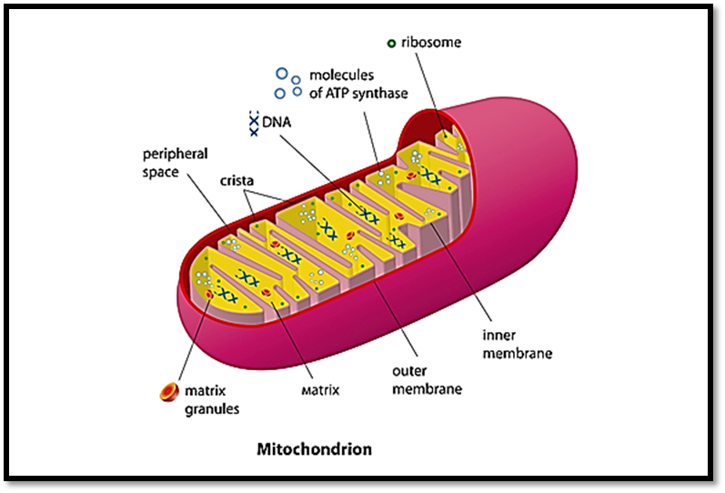

Slide 8
Function of Mitochondria
The functions of mitochondria depends on the cell type in which they are present:
1- The most important function is produce energy. The simpler molecules of nutrition are sent to the mitochondria to be processed and to produce charged molecules. These charged molecules combine with oxygen and produce ATP
( adenosine triphosphate )molecules. This process is known as oxidative

Slide 9
2- Help the cells to maintain proper concentration of calcium ions within the compartments of the cell.
3- It also help in building certain parts of blood and hormones like testosterone and estrogen.
4- The liver cells mitochondria have enzymes that detoxify ammonia

Slide 10
5- Play important role in the process of apoptosis or programmed cell death, abnormal death of cells due to the dysfunction of mitochondria can affect the function of organ.

